Slide 1


SMART INDIA HACKATHON 2024
Problem Statement ID - 1757
Problem Statement Title - India Post A Bridge for Indian Diaspora to access things Indian "Building a community of Indian Diaspora for meeting their needs of Indian Products (traditional / ethnic / handicrafts) through India Post by connecting PIOs with local sellers / MSME / Artisans" , Ministry Of Communication
Theme – Transportation and Logistics
PS Category - Software
Team Member names with USN
Team Name - BharatiVaR
Name | USN | Stream | Gender
G Lakshmi Anugnya | 1RVU23CSE160 | BTECH CSE 2ND YEAR | Female
Sujay V Kulkarni | 1RVU23CSE482 | BTECH CSE 2ND YEAR | Male
Aditya S Maller | 1RVU23CSE030 | BTECH CSE 2ND YEAR | Male
Kirthan | 1RVU23CSE223 | BTECH CSE 2ND YEAR | Male
Vaibhav Kumar | 1RVU23CSE520 | BTECH CSE 2ND YEAR | Male
Ramyashree G | 1RVU23BSC118 | BSC CSE 2ND YEAR | Female

Slide 2
Bridging Heritage and Artisans with Remarkable Advanced Technology for International Ventures and Reach
BharatiVaR
BharatiVaR
Problems & Solutions
Product
App/WebApp
USP
Validating Sellers
Rating System
External Verification Body
Validating Products
Post office handles funds
Secure payment
Seller Validation
Secure Delivery Process
Virtual Reality Market
Connecting Artisans and Indian Diaspora
Integration with Indian Post
Virtual Reality Shopping
Smart Packaging

Slide 3
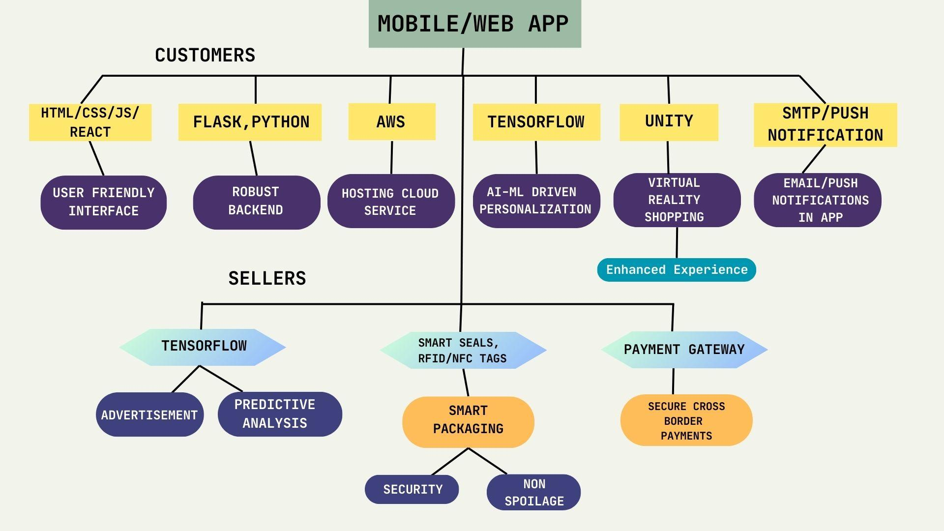
TECHNICAL APPROACH
BharatiVaR
https://bit.ly/bhartivarpoc
POC Link:
https://bit.ly/bhartivargit
Github Repo Link:
We wrote a Scopus Q1 paper to analyse opportunity and business in this. It is : Here
We also wrote a Research paper to explain the technology stack and usage and explanation of all the technologies in this. It is : Here

Slide 4
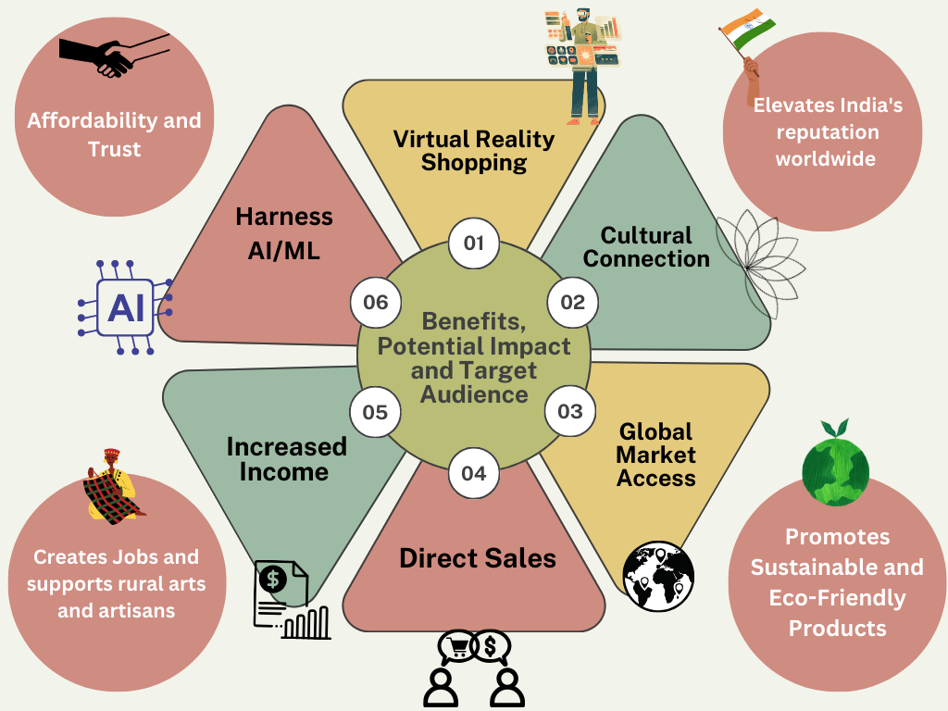
IMPACT AND BENEFITS
BharatiVaR

Slide 5
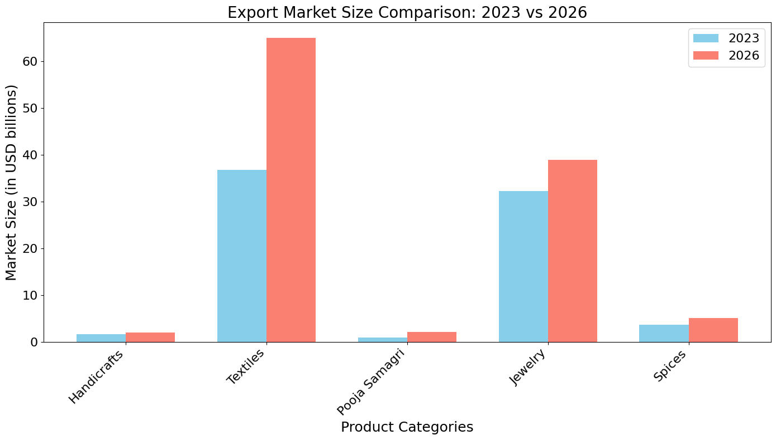
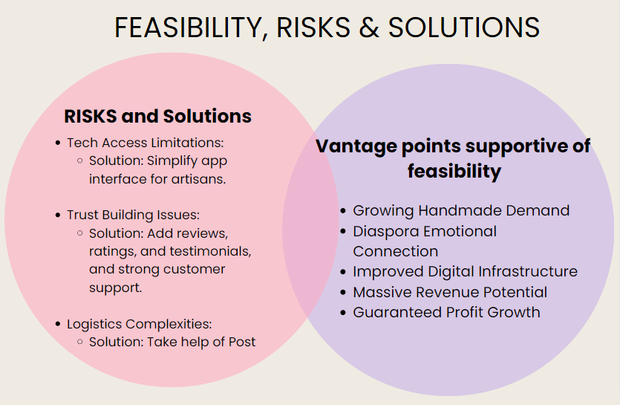
FEASIBILITY AND VIABILITY
BharatiVaR

Slide 6
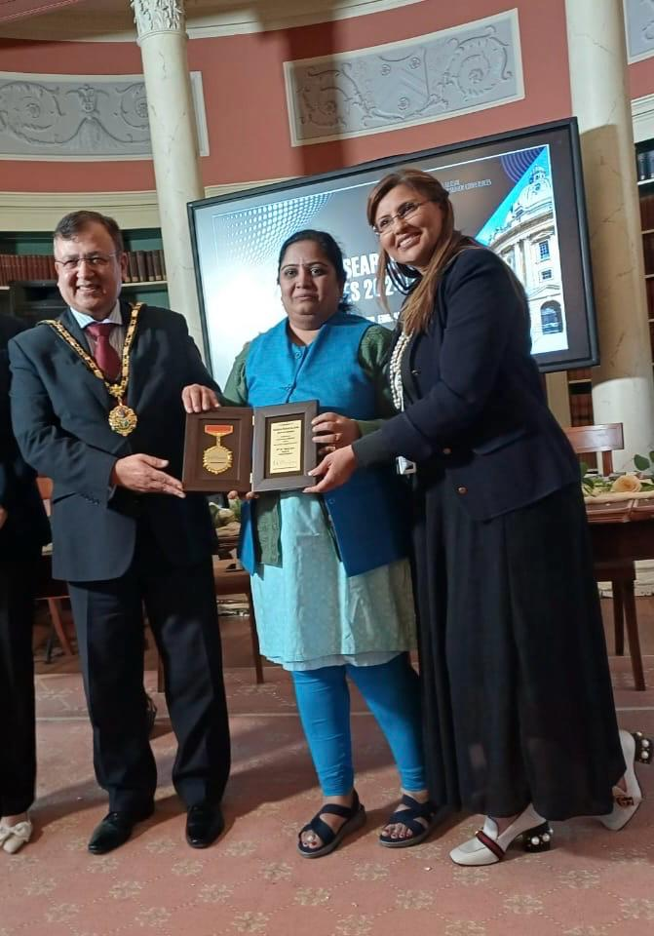
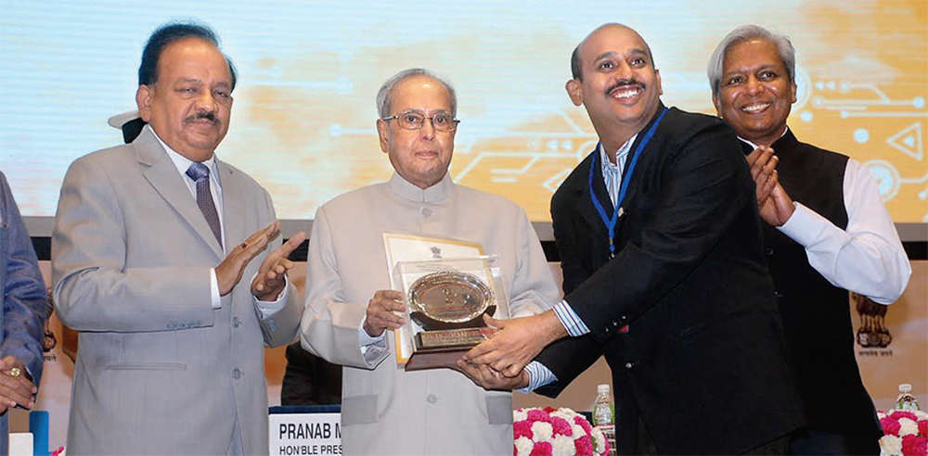
RESEARCH AND REFERENCES
BharatiVaR
Mentors:
Unity Technologies, "Virtual Reality Overview",Unity Manual, vol. 34, pp. 95-105, 2023. [Available: https://docs.unity3d.com/Manual/VROverview.html.]
M. Chand, "Diasporas, Migration, and Trade: The Indian Diaspora in North America", Journal of Enterprising Communities: People and Places in the Global Economy, vol. 6, no. 4, pp. 383-396, 2012.[Available: https://doi.org/10.1108/17506201211272805.]
Ministry of Textiles, "Indian Handicrafts Portal", Government of India, 2023. [Available: https://indian.handicrafts.gov.in/en]
V. S. S. Kiran, "Improving MSME Efficiency Through Data-Driven Insights", IEEE Transactions on Industrial Informatics, vol. 20, no. 4, pp. 2250-2261, 2024. [Available: https://ieeexplore.ieee.org/document/9588857]
Dr Phani Kumar Pullela
Recipient of President of India Award 2017
Patent and Trademark Agent
Associate Dean of School of Computer science and Engineering, RV University
Dr. Suchitra Joshi
Head of India Operations, Target Close Technologies
Recipient of Eminent Speaker Award, Oxford university, United Kingdom and Power Women Award

